Slide 1
AirStrip Management system using DEVS JAVA
Yasaswini Kandru
Naveen Syamala

Slide 2
Content
Problem Statement
Assumptions
Atomic models
Queue Results
Plot for clock values

Slide 3
Airstrip management system will manage the airstrip for the flights landing or take off.
Airstrip management system will manage the airstrip for the flights landing or take off.
Airstrip management system will manage the airstrip for the flights landing or take off.
Airstrip management system will manage the airstrip for the flight’s landing or take off.
We have landing and takeoff requests from domestic and international flights.
Problem Statement

Slide 4
Assumptions
Only one flight can access the airstrip at a time.
The flights get permission to use airstrip, then all other requests are queued.
Once the airstip is free, then the first element from queue gets to use the airstrip.
If there are no requests in the queue, the airstrip will be in passive state.

Slide 5
DomesticLandingGenerator
DomesticTakeoffGenerator
DomesticAirstripController
InternationalLandingGenerator
InternationalTakeoffGenerator
InternationalAirstripController
AirstripSystem
Atomic Models

Slide 6
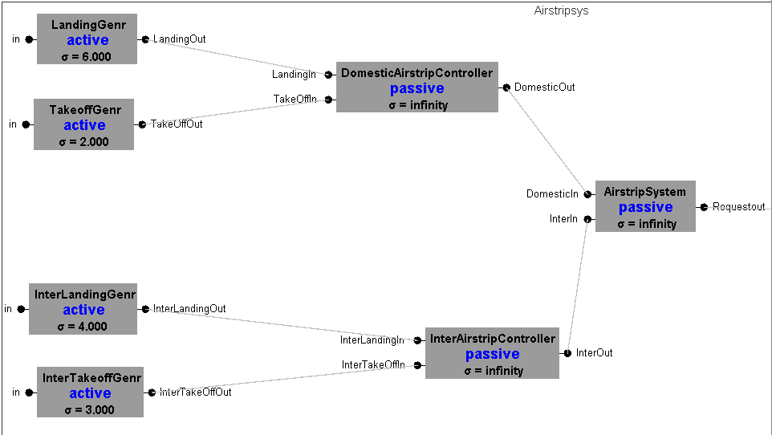

Slide 7


Slide 8
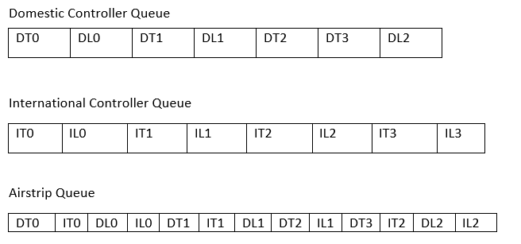
Queue Results
Image

Slide 9
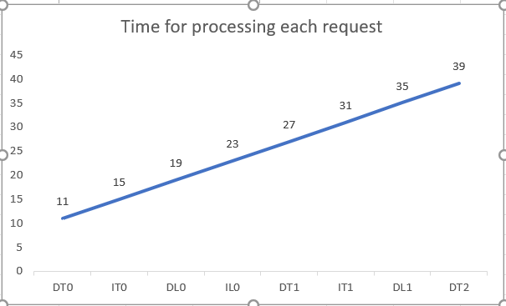
Clock Values

Slide 10
Thank You

